Slide 1


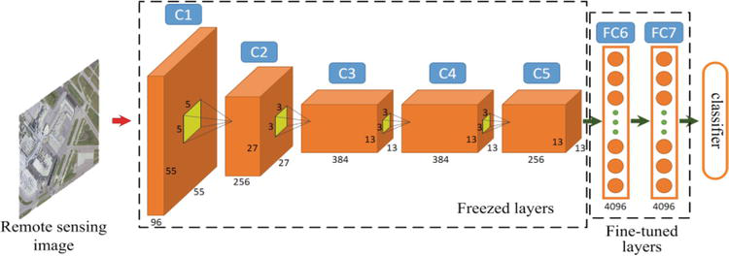
ML for Earth & Env Sci (Week 5, SP2022)
How can we extract information from images/videos using deep learning?
Source: Luo et al. (2018)
Notes:
COSERO hydrological model

Slide 2
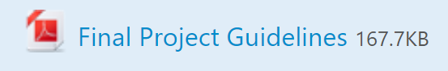
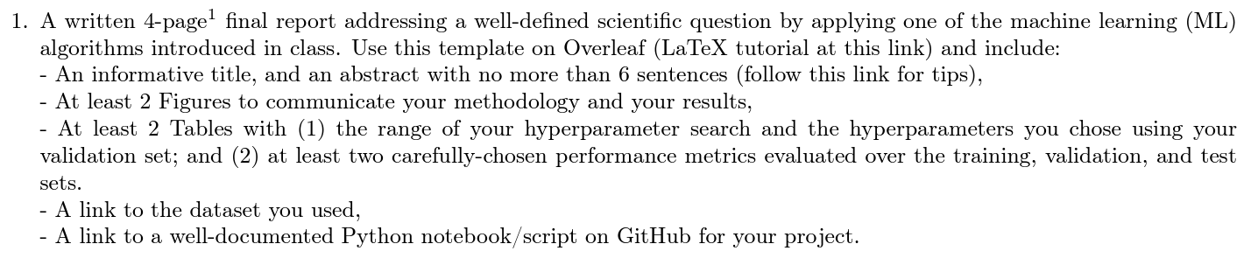
In-class Peer Review: Wed, Dec 14th , 1PM-3PM
Submit first draft of your project by Tue, Dec 13th

Slide 3
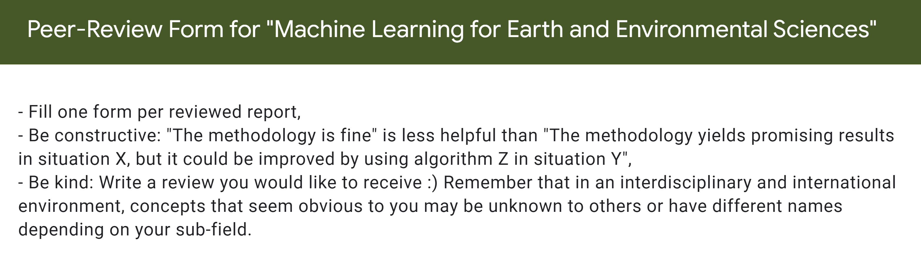
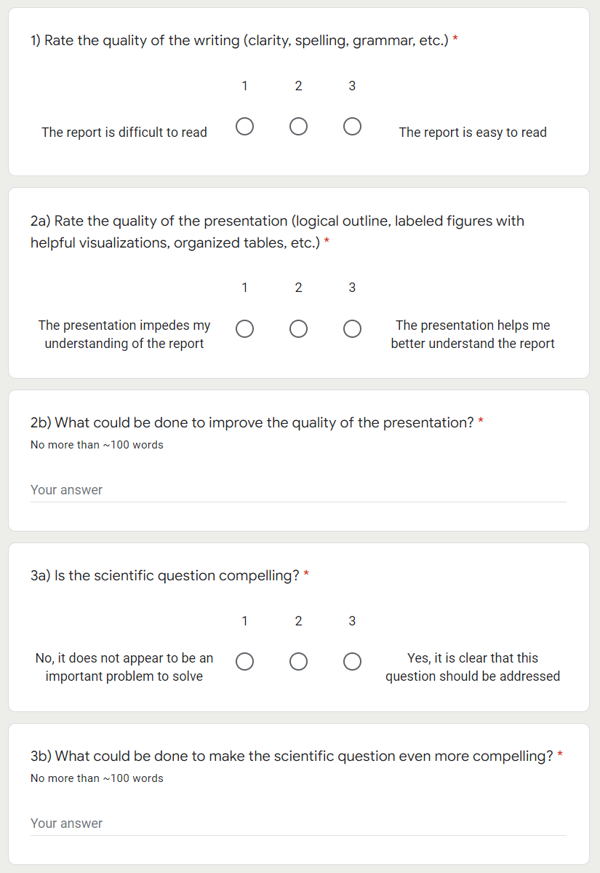
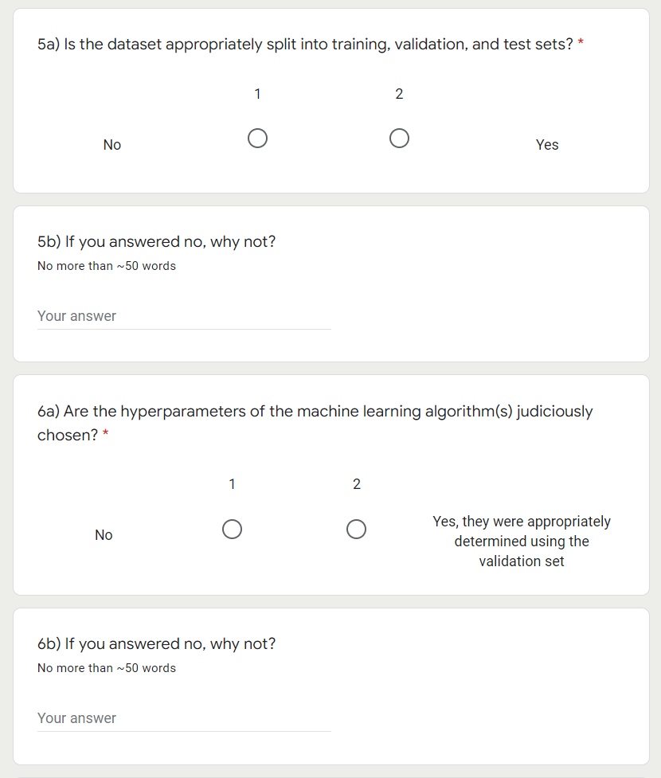

Slide 4
Final Presentations in room 2138 Friday, Dec 16th from 8AM to 10AM (Register)
4min presentations + 1min Q&A
Tip = 1 slide/minute
Scientific question: What’s our goal and why do we care?
Dataset: Characteristics, challenges, training/validation/test split, etc.
Methodology: Which ML algorithm(s) did you choose and why?
Results: What are your findings and how does it answer the sci. question?

Slide 5
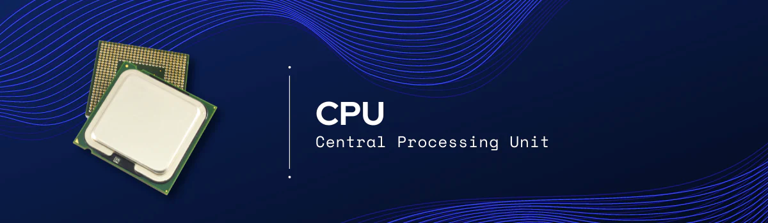
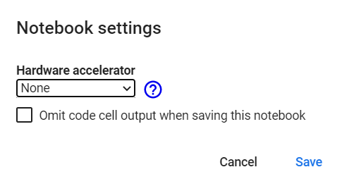

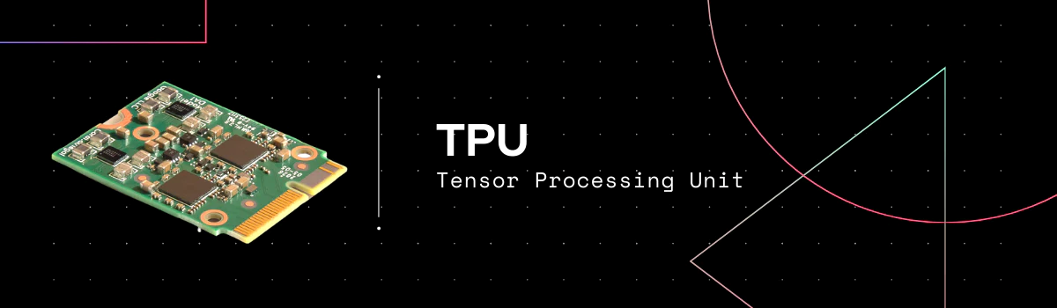
Has several cores but very precise
Executes instructions serially
Good for large models (large RAM), small batch sizes, custom calcs.
Has thousands of cores
Specialized for parallel processing
Good for larger batch sizes and deep learning in general
Specialized for matrix processing
Good for large batch sizes & CNN
(Edit menu)
Source: https://premioinc.com/blogs/blog/what-is-the-difference-between-cpu-vs-gpu-vs-tpu-complete-overview
Notes:
We talked about computational time, let’s briefly introduce hardware

Slide 6
Min 20-45: Convolutional Neural Networks to Process Images
Learning Objectives (Géron Ch14):
Define a convolutional neural network
Discuss the main applications of convolutional neural networks
Know the steps to design and train a convolutional neural network
Define transfer learning and understand how to re-use pre-trained models

Slide 7
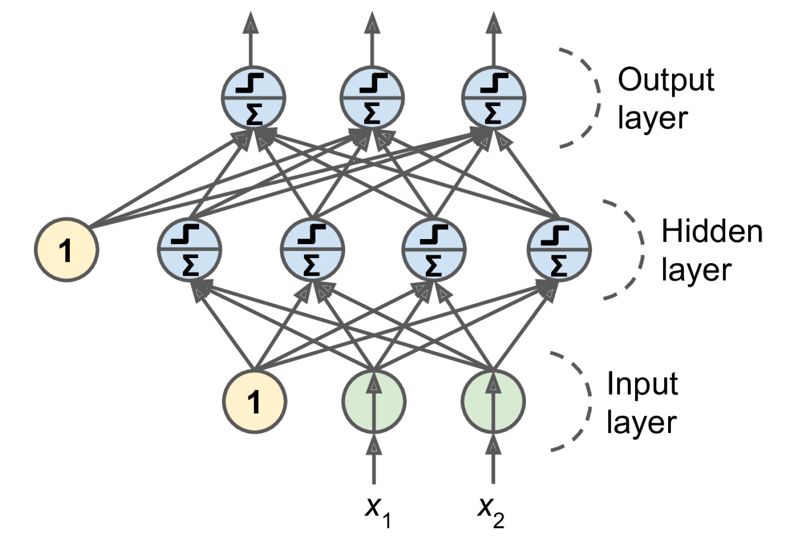
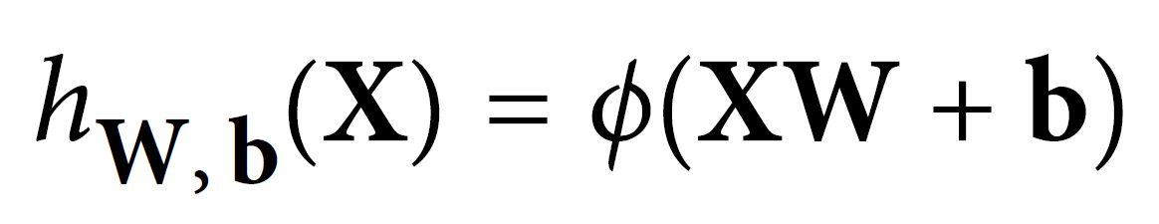
Last week = general case: Artificial Neural Networks
Notes:
1 layer = similar to logistic regression
2 layers = shallow neural network
Deep learning = 3 layers and above

Slide 8


This week: Convolutional Neural Networks (CNNs)
Regularized versions of Artificial Neural Networks used to process images
Source: Giphy, Analytics India Magazine (K. Maladkar)

Slide 9
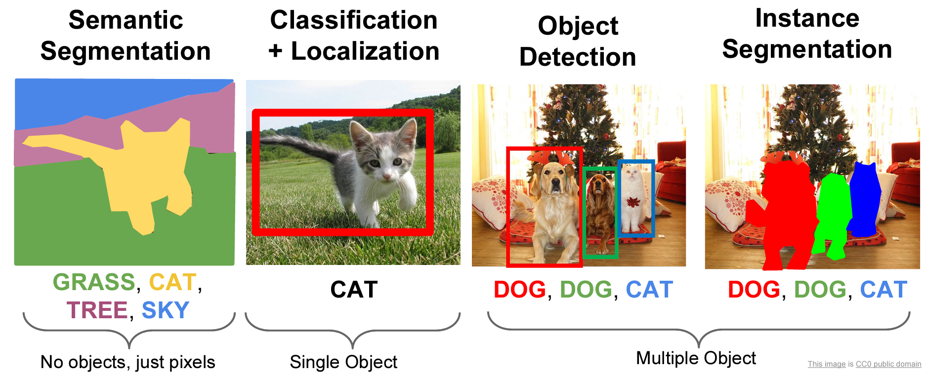
CNNs used for computer vision (analyzing images, videos)
Source: Stanford (CS231)

Slide 10
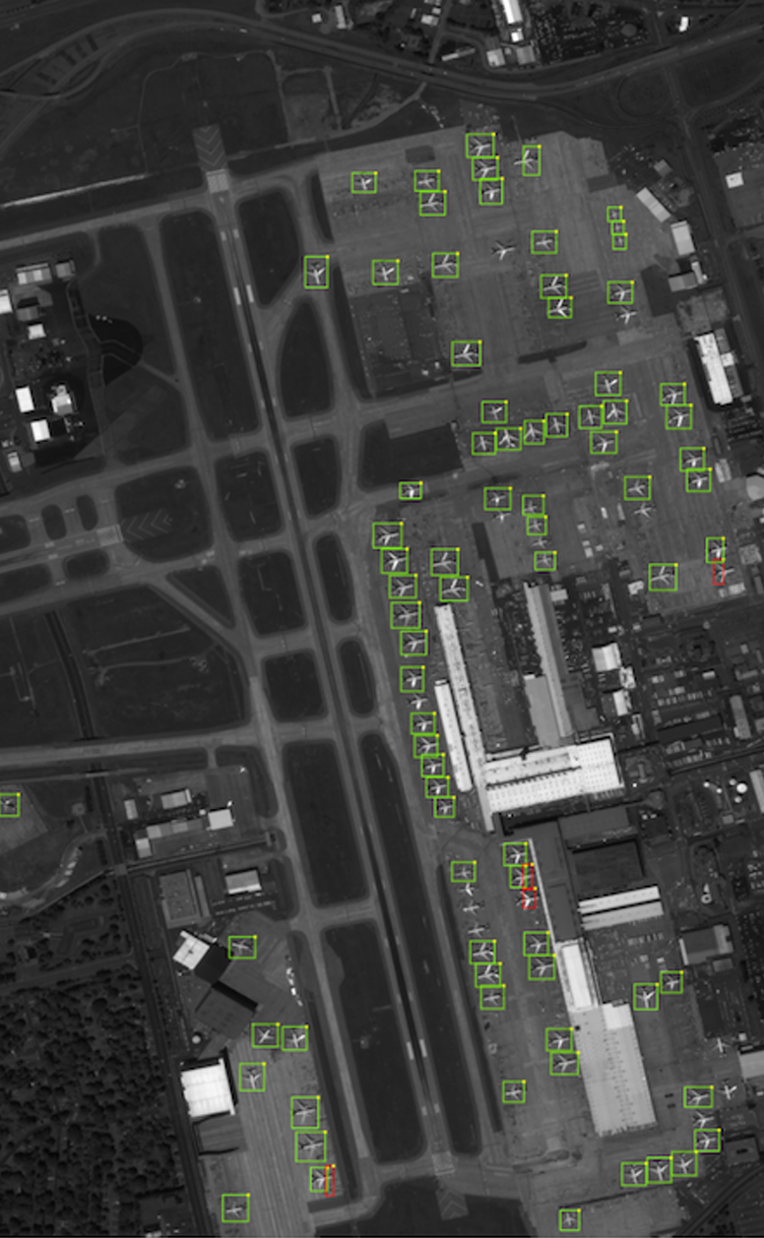
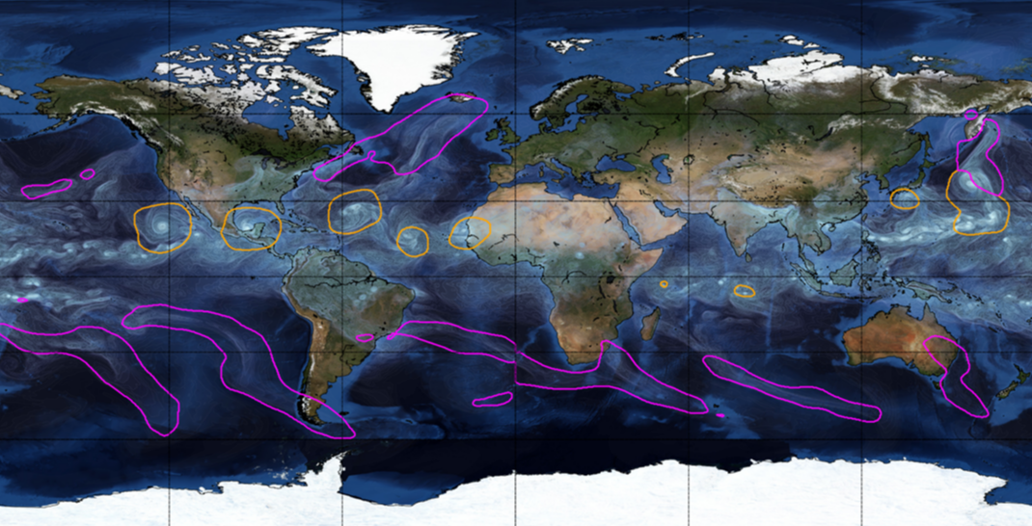
Object Detection for Remote Sensing
Instance Segmentation for Storm Detection
Source: Zhu et al. (2017), Prabhat et al. (2020)

Slide 11
Environmental Applications
Object Detection
Semantic Segmentation
catchment was flooded
classify parts of a catchment as being flooded or not.
In forestry, it could be classifying a remote sensing image into forest and non-forest
identifying every single tree in an image
"draw" the boundary of each rock glacier, individually
you will know for each pixel if this pixel "is in" a rock glacier, but you will not be able to know how many there is, just where there are rock glaciers on the picture

Slide 12
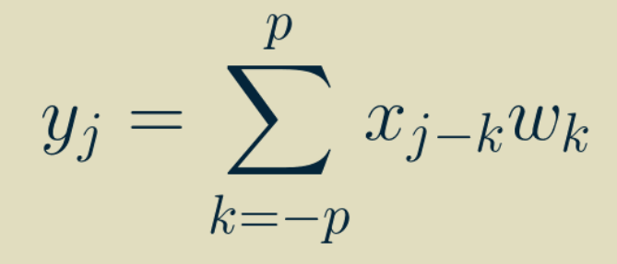
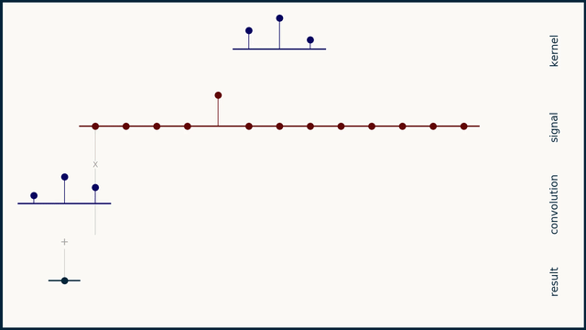
One-dimensional Convolution
Output
Input
Weights
Simple & inexpensive
Source: Brandon Rohrer

Slide 13
Two-dimensional Convolution
↓
Two-dimensional weights
(Kernel, Filter)
3 x 3 receptive field

Slide 14
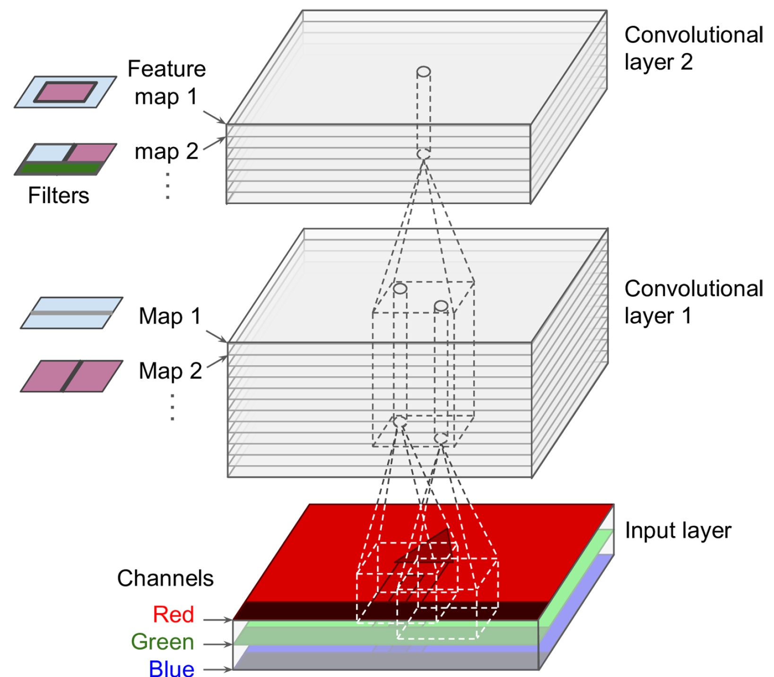
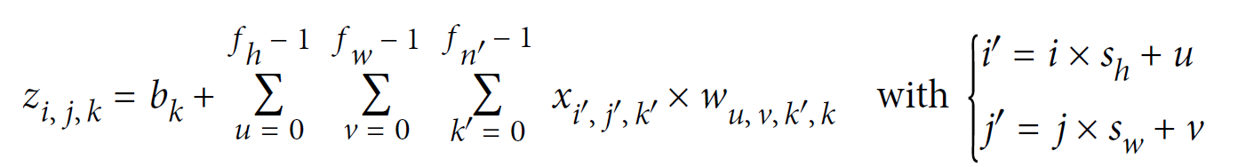
Two-dimensional Convolution with Multiple Features
Output
Input
Weights
Stride
Sum over height
Sum over width
Sum over features

Slide 15
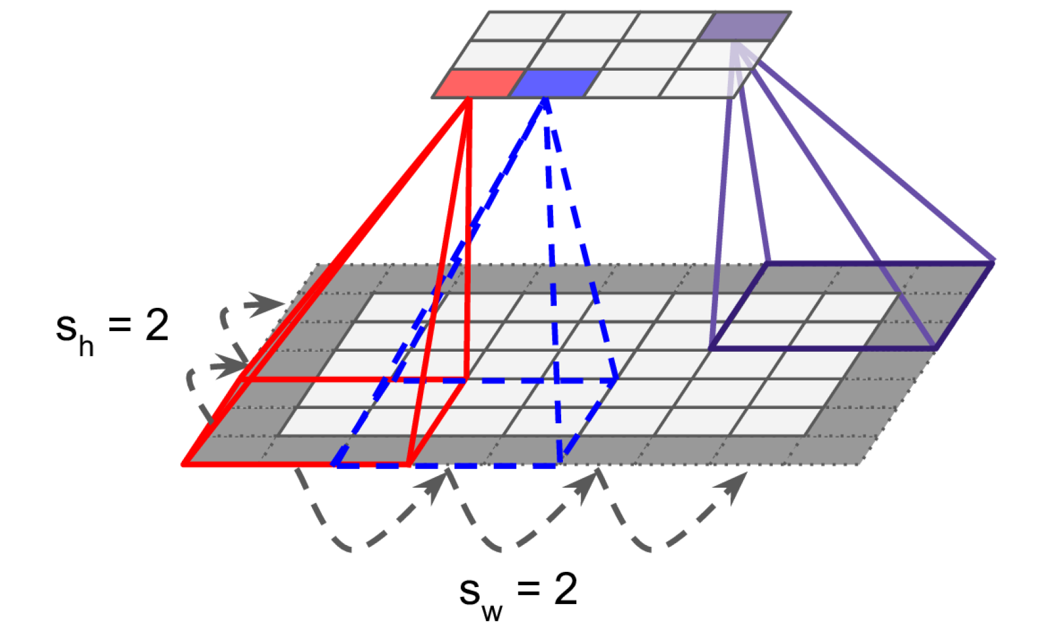
Reducing dimensionality using strides
Stride = “How much you move the filter by in each direction”
Stride is one of the features used in defining the movement of the filter layer, which defines the amount of movement of the filter on the image. Each movement of the filter on the input image will produce one value, contributing to the output image. Now, if the stride is large, it means that the filter takes a big step at each step and, therefore, will produce fewer values and a smaller output compared with the original input.

Slide 16

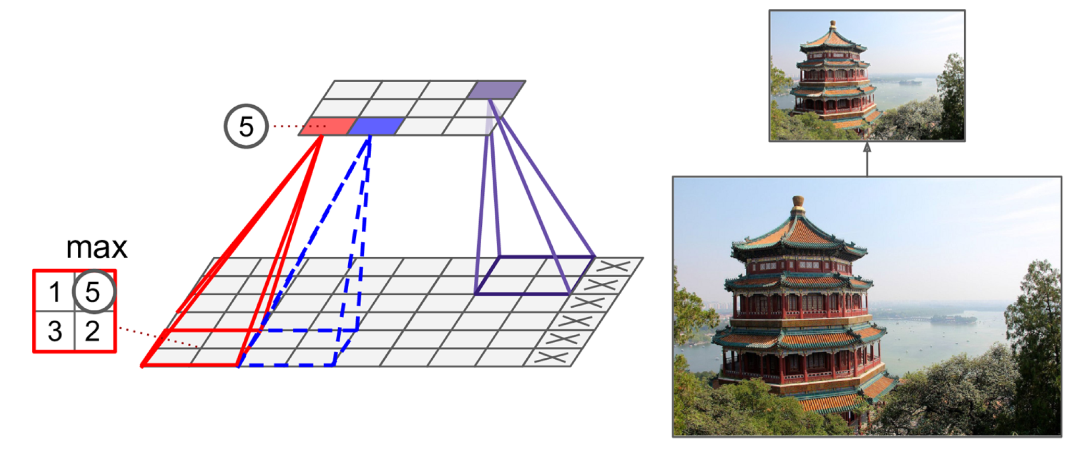
Shrinking the Input Image using Pooling Layers
Alternative: Mean/Average pooling
Notes:
Explain Difference between pooling and convolutional layer

Slide 17
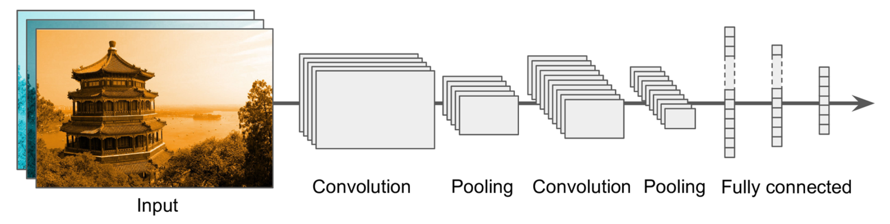

Building a Convolutional Neural Network
Prepare and load image dataset
Not enough data!

Slide 18
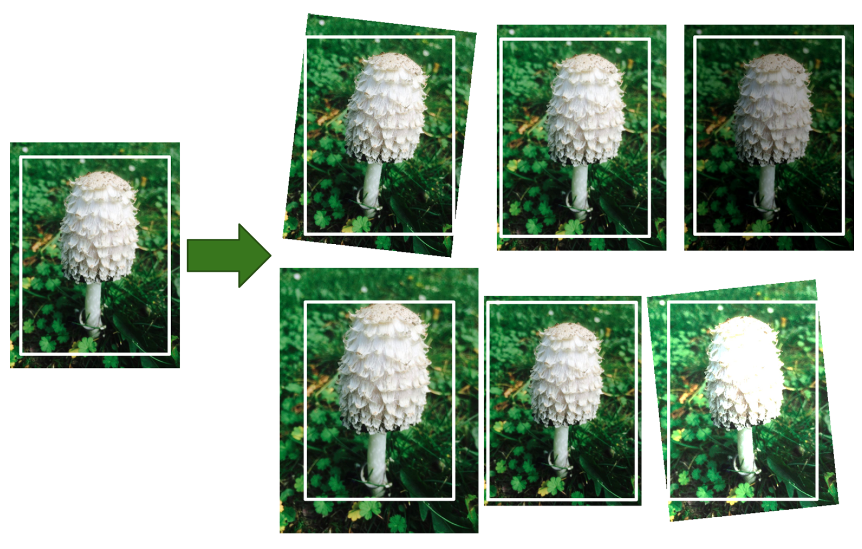
Data Augmentation = Generate realistic variances of each training instance (rotation, translation, resizing…)
Bonus: Regularizes the model

Slide 19
Building a Convolutional Neural Network
Prepare and load image dataset
First Convolution Operation
Image shrinks

Slide 20
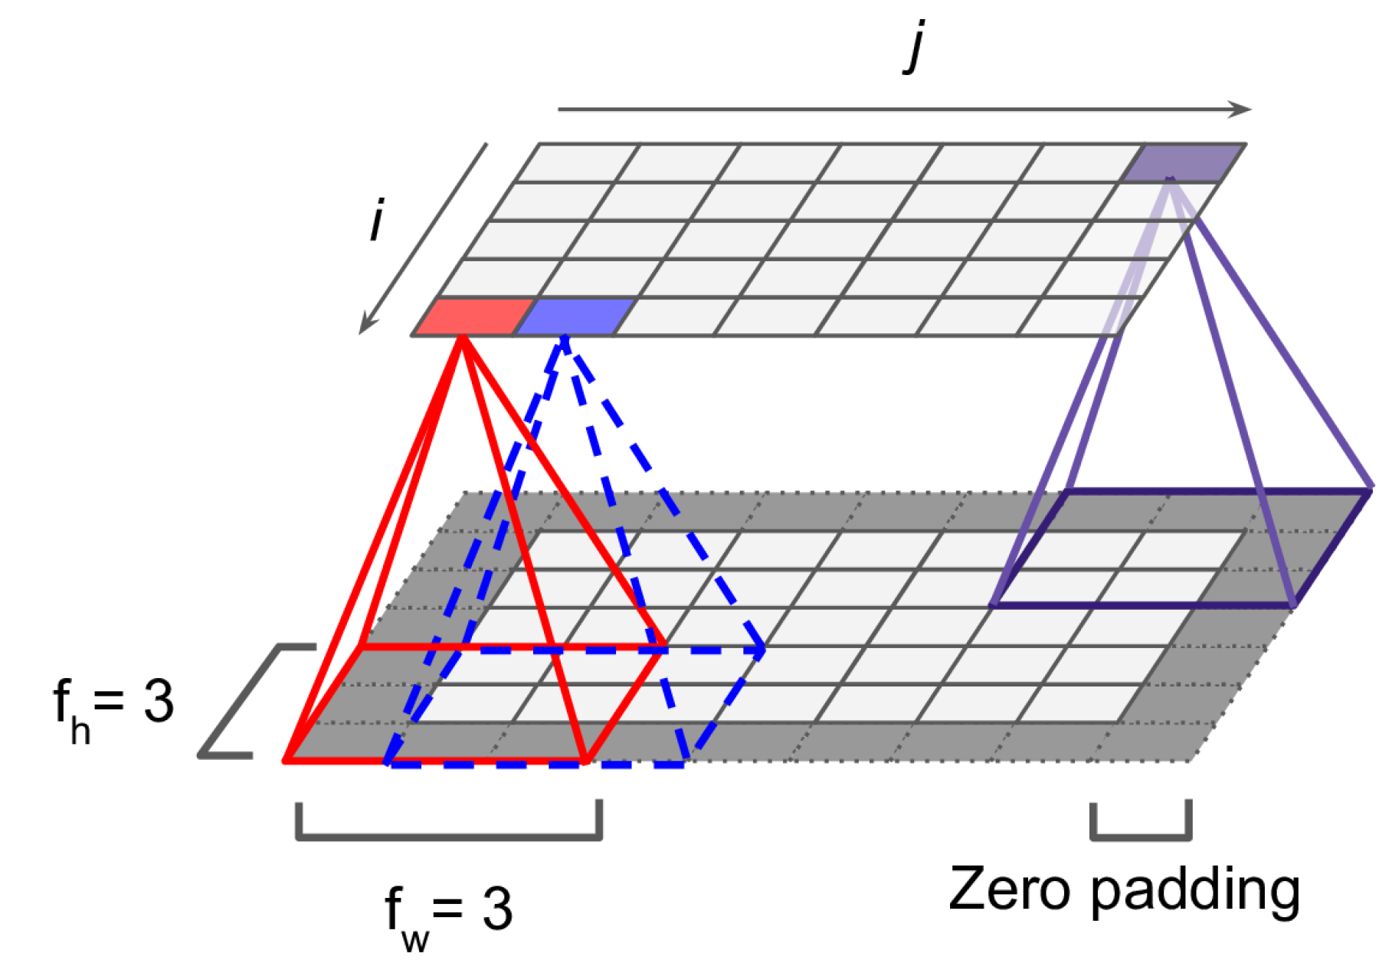
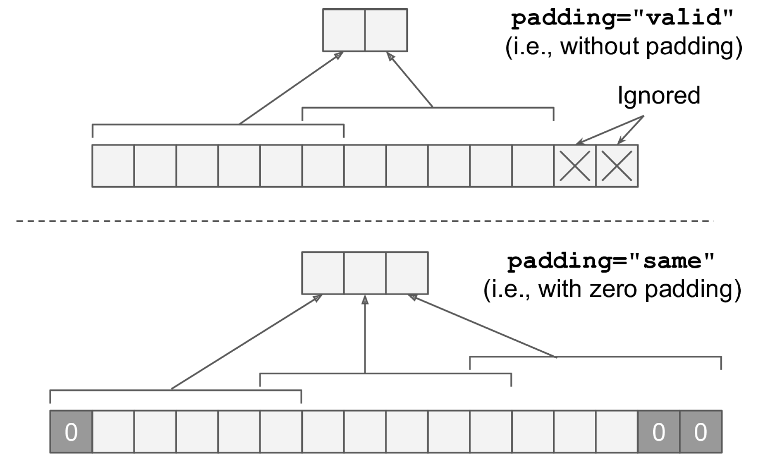
(Zero) padding to preserve the dimension of the input

Slide 21
Building a Convolutional Neural Network
Prepare and load image dataset
First Convolution Operation
Series of convolution+pooling
Dense layers

Slide 22
Train using appropriate loss (↓RAM use: ↓batch size, ↓layers, ↑strides, etc.)
Prepare and load image dataset
First Convolution Operation
Series of convolution+pooling
Dense layers

Slide 23

Building a Convolutional Neural Network
Prepare and load image dataset
Still not enough data!

Slide 24

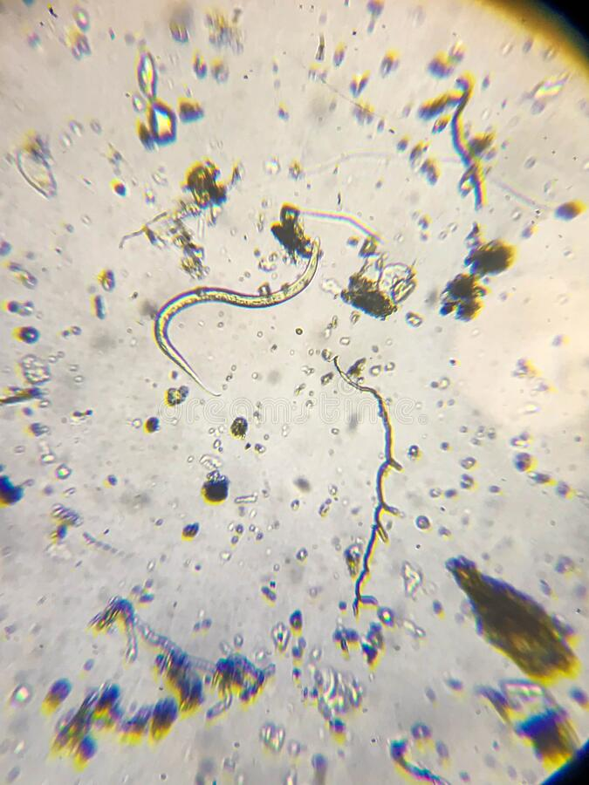
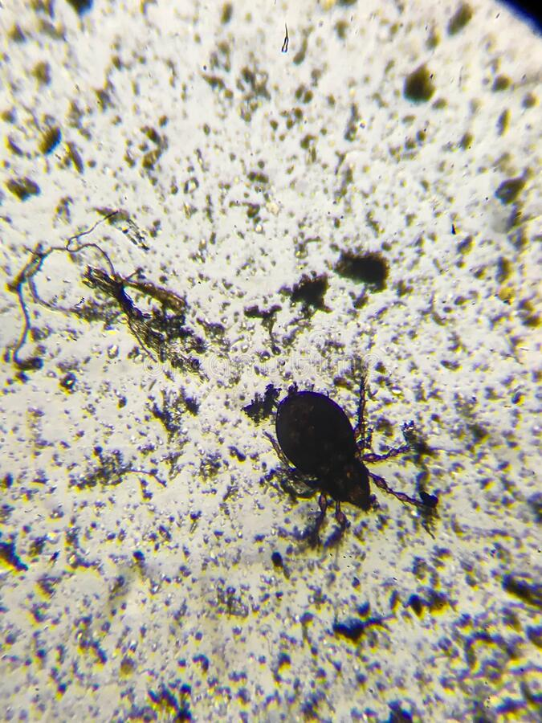
Transfer Learning = Reusing trained model for a different problem
?
↔
Source: ImageNet, Dreamstime.com

Slide 25
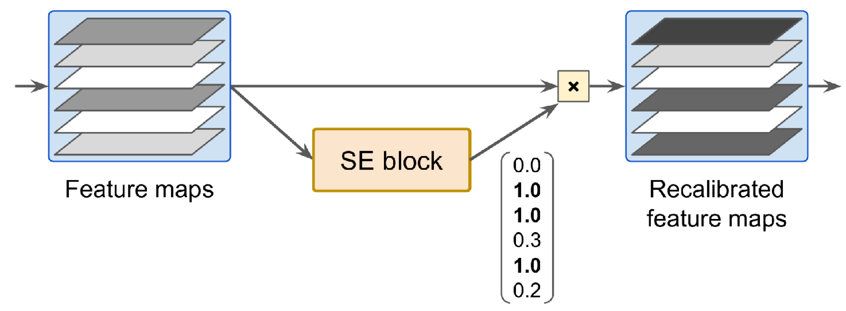
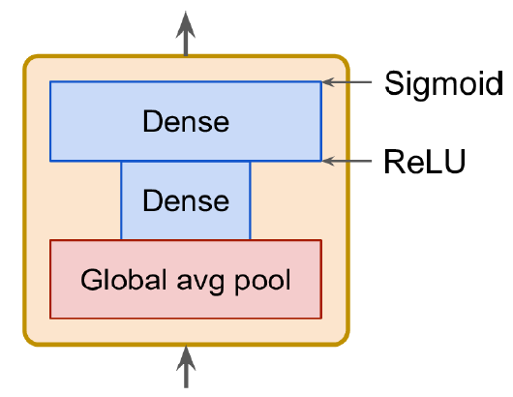
Which model to choose?
See Géron Ch14 for list of high-performance models:
AlexNet (Stacked convolutions + local response normalization)
SENet (Adds small neural networks to recalibrate feature maps)
Fully-convolutional architectures (process images of various sizes)

Slide 26
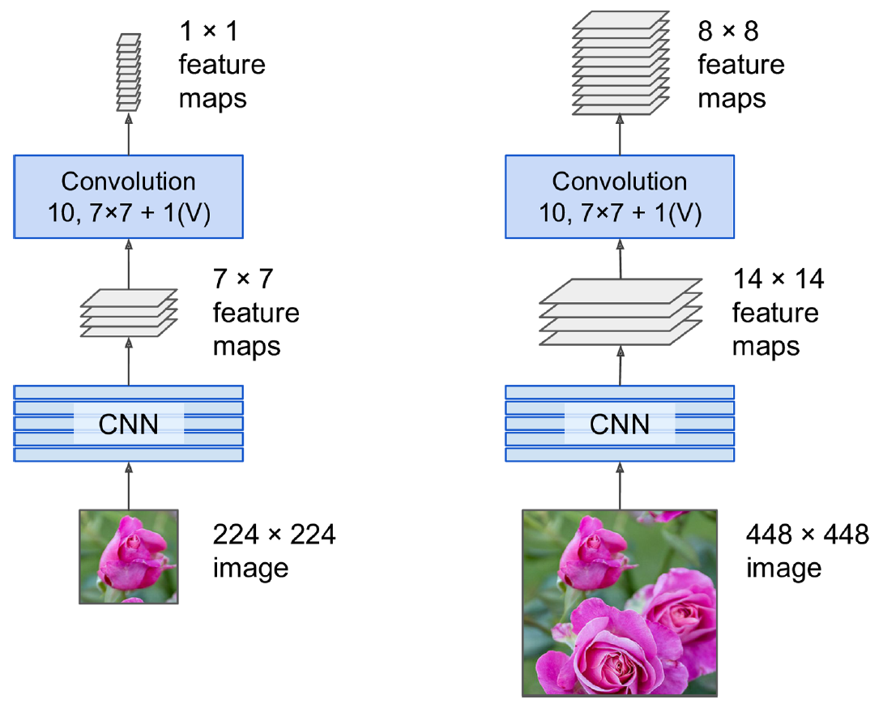
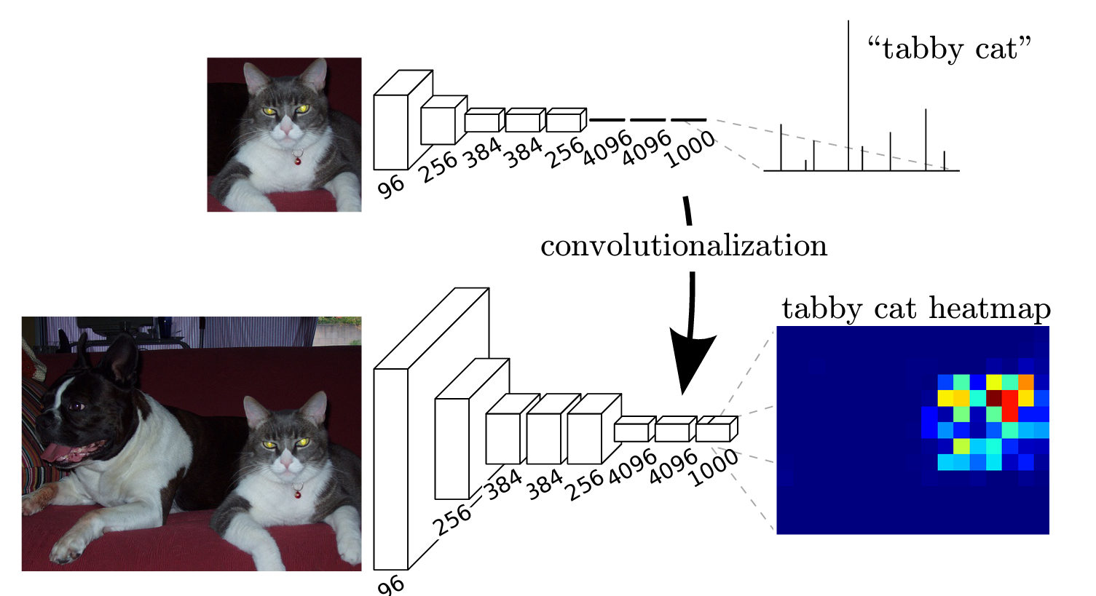
Fully-Convolutional Network = No dense layers Can process image of any size for semantic segmentation
Source: Long et al. (2015)

Slide 27
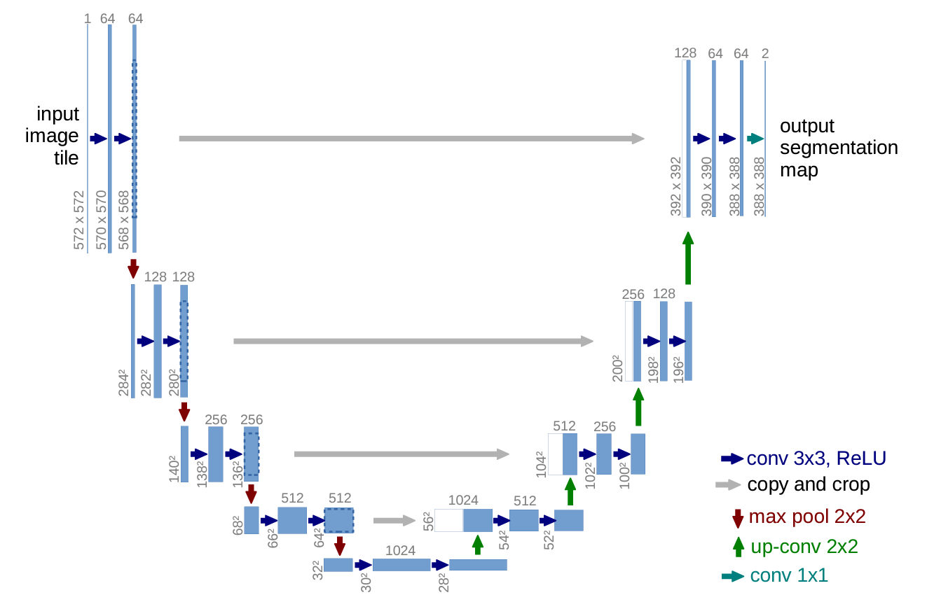
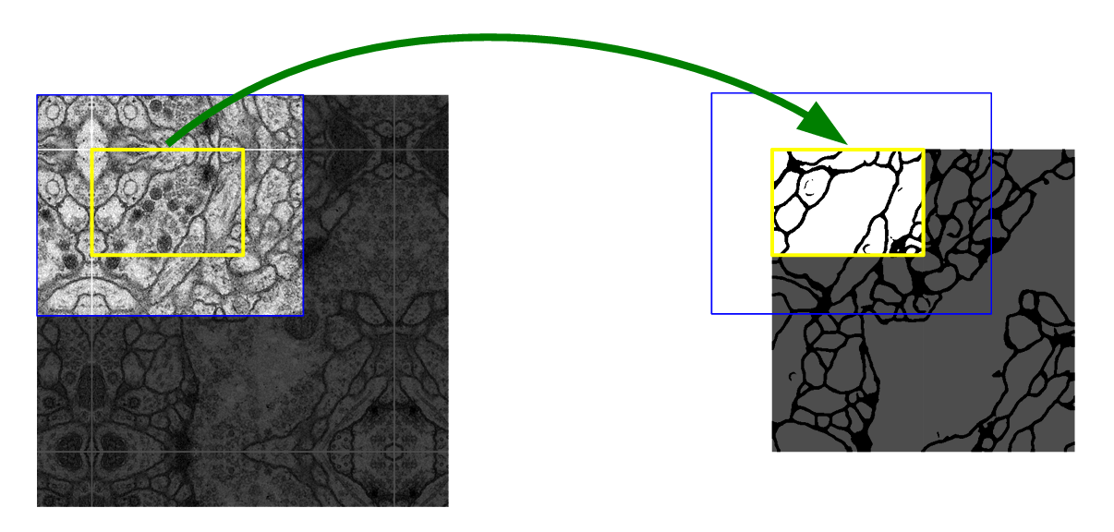
U-Net: Initially developed for biomedical image segmentation. Retains localization information
Source: Ronneberger et al. (2015)

Slide 28
Transfer Learning = Reusing trained model for a different problem
Pick a model to reuse
Load the trained weights corresponding to a similar dataset
Retrain parts of the model - Freeze existing layers & add dense layers to train - Retrain the first layers of model (closest to the image, most specialized)

Slide 29
Min 45-60: Moodle Quiz (5 questions, 15 min)
Learning Objectives (Géron Ch14):
Define a convolutional neural network
Discuss the main applications of convolutional neural networks
Know the steps to design and train a convolutional neural network
Define transfer learning and understand how to re-use pre-trained models
Notes:
Questions?
Not graded

Slide 30
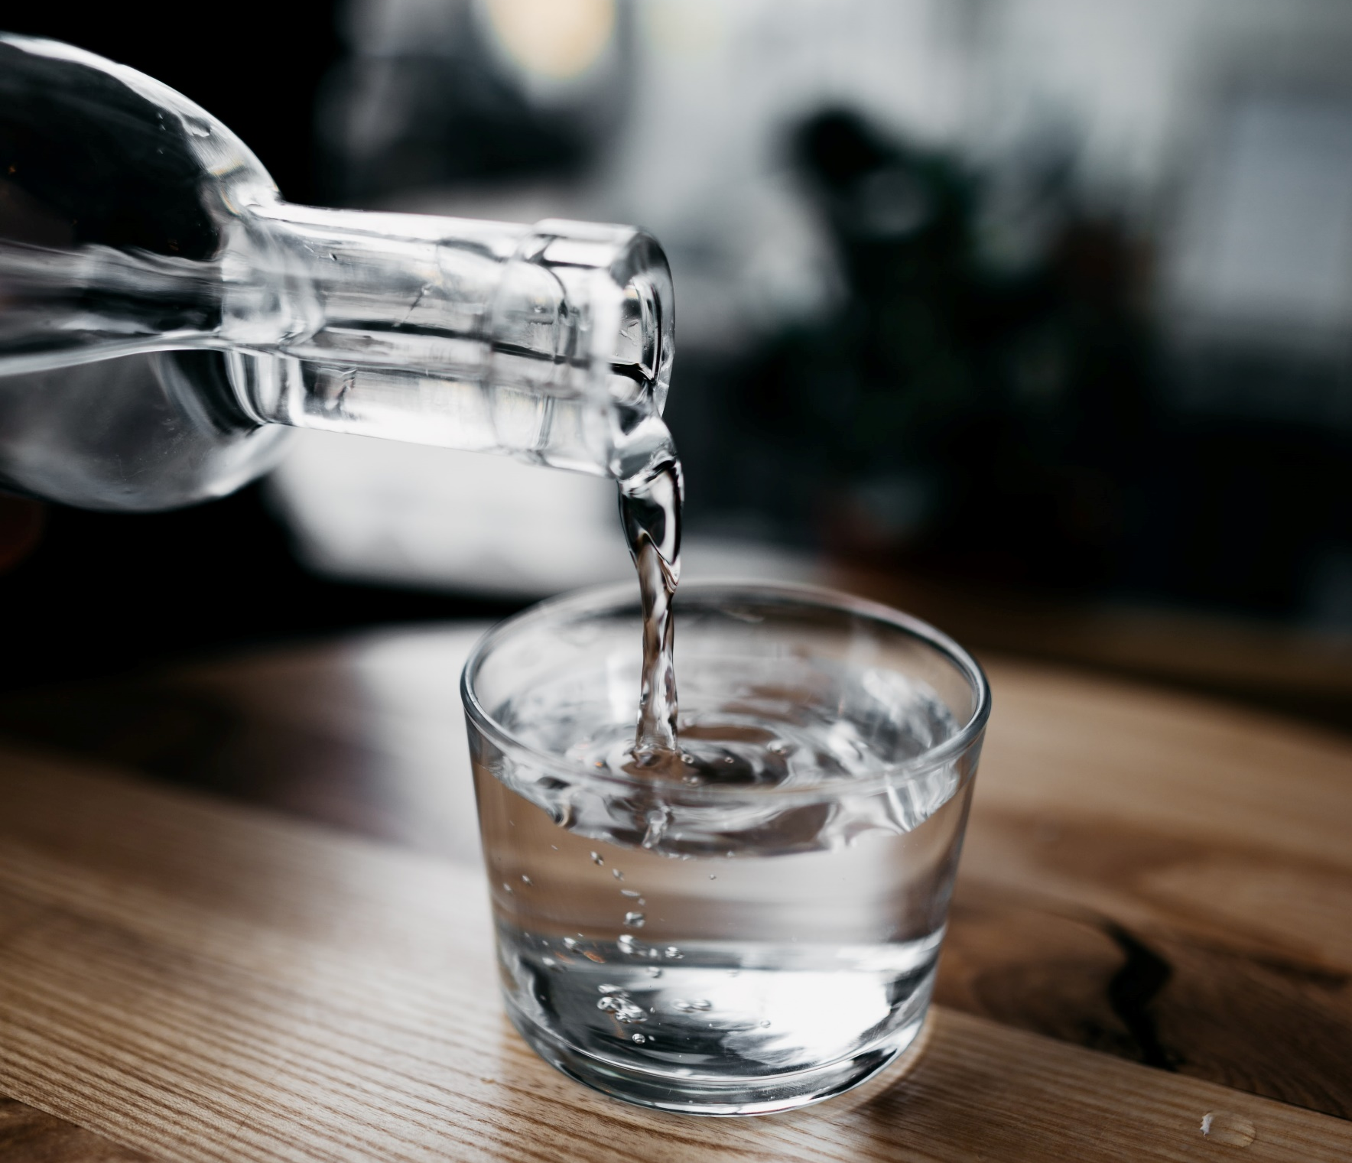
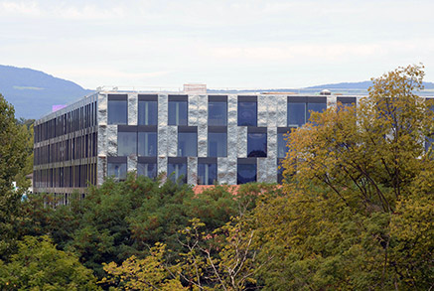
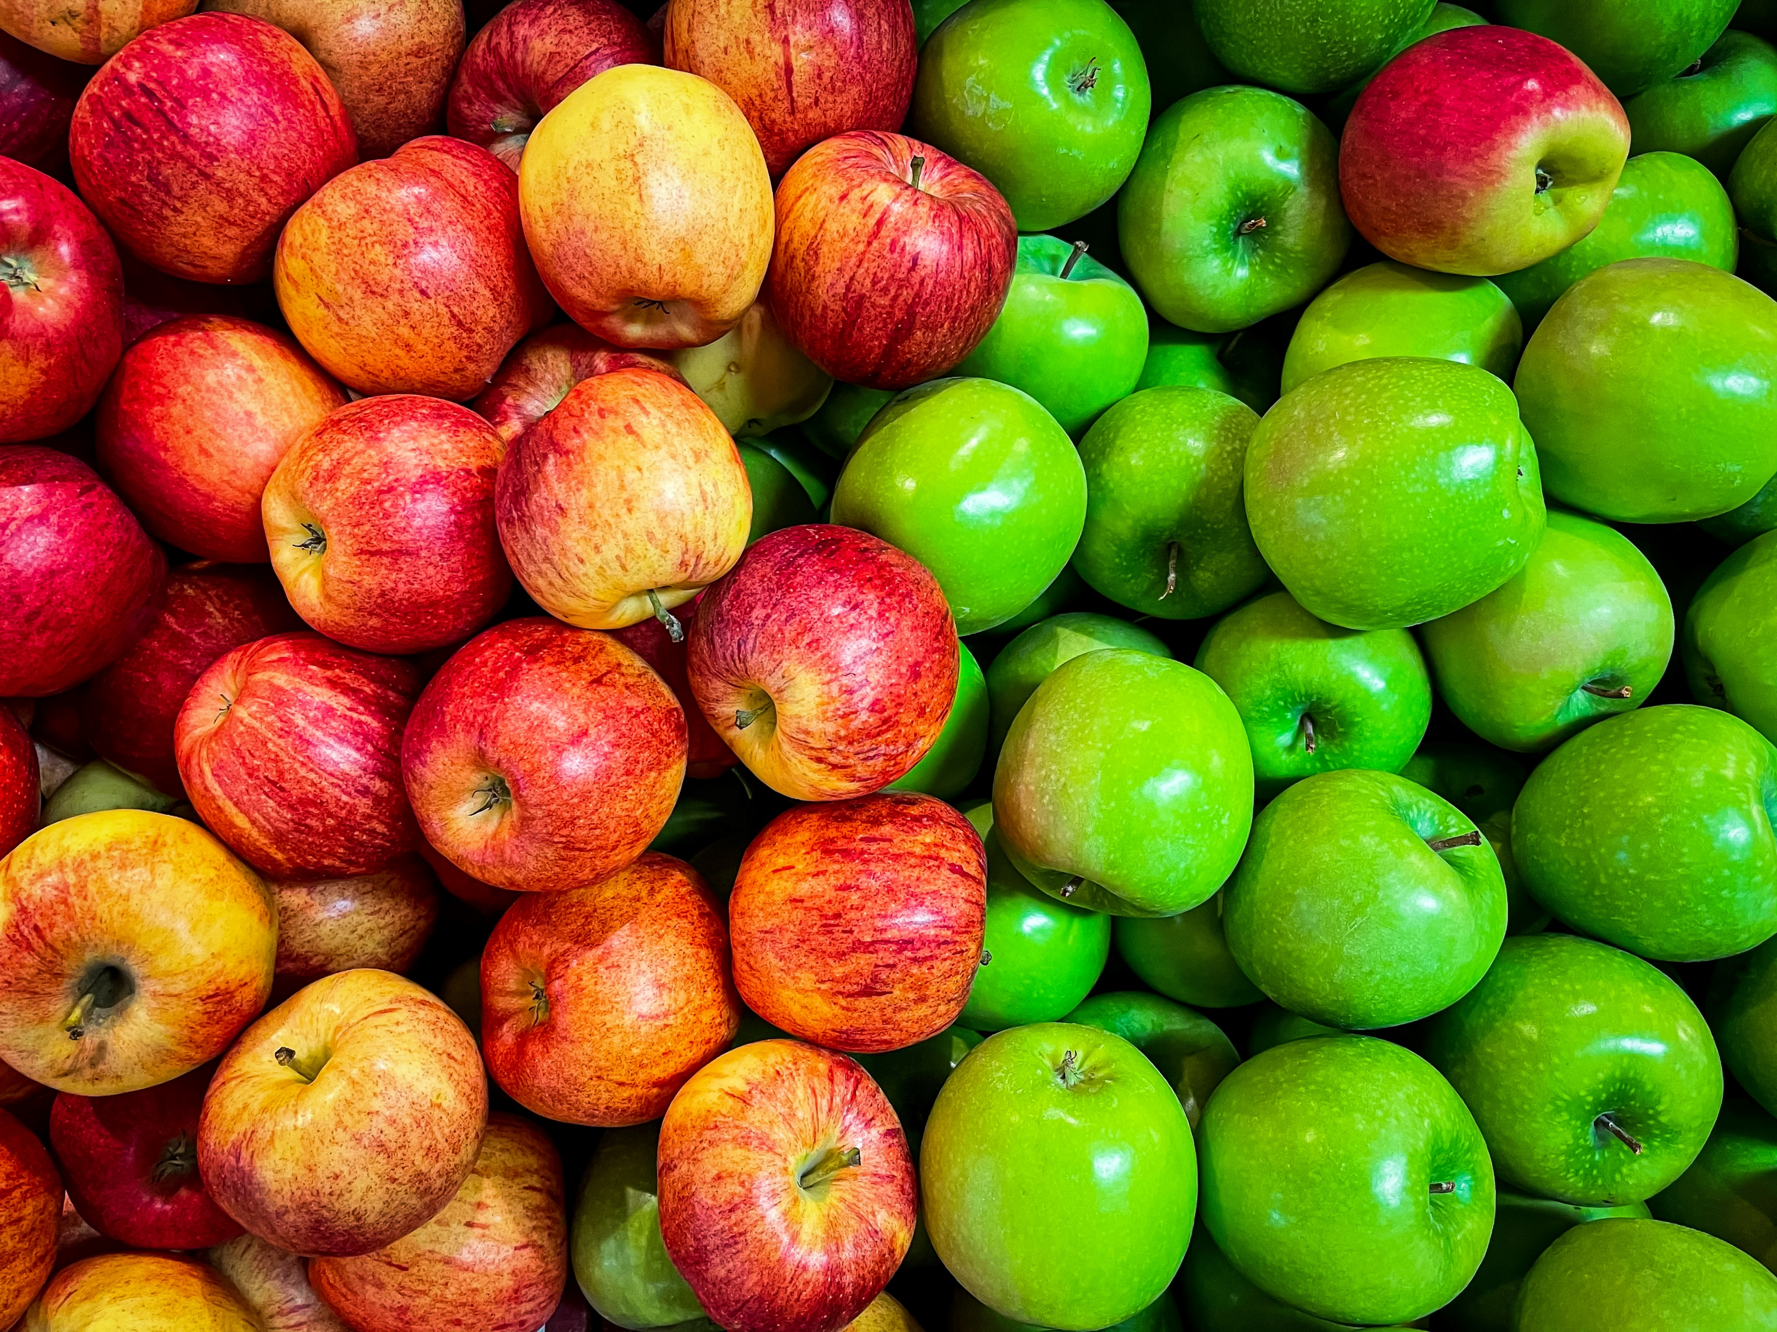
Min 60-75: Break

Slide 31
Min 75-105: Remote Sensing Image Classification using CNNs (Optional Reading 3)
Learning Objectives (Géron Ch14):
Define a convolutional neural network
Discuss the main applications of convolutional neural networks
Know the steps to design and train a convolutional neural network
Define transfer learning and understand how to re-use pre-trained models
Additional Learning Objective: 6. Define a benchmark dataset & 7. Address class imbalance

Slide 32

Min 75-85: Re-read the article and write down (1) the scientific goal of the paper; (2) One simple question with your neighbor.
Example: Can you remind us what accuracy is?

Slide 33
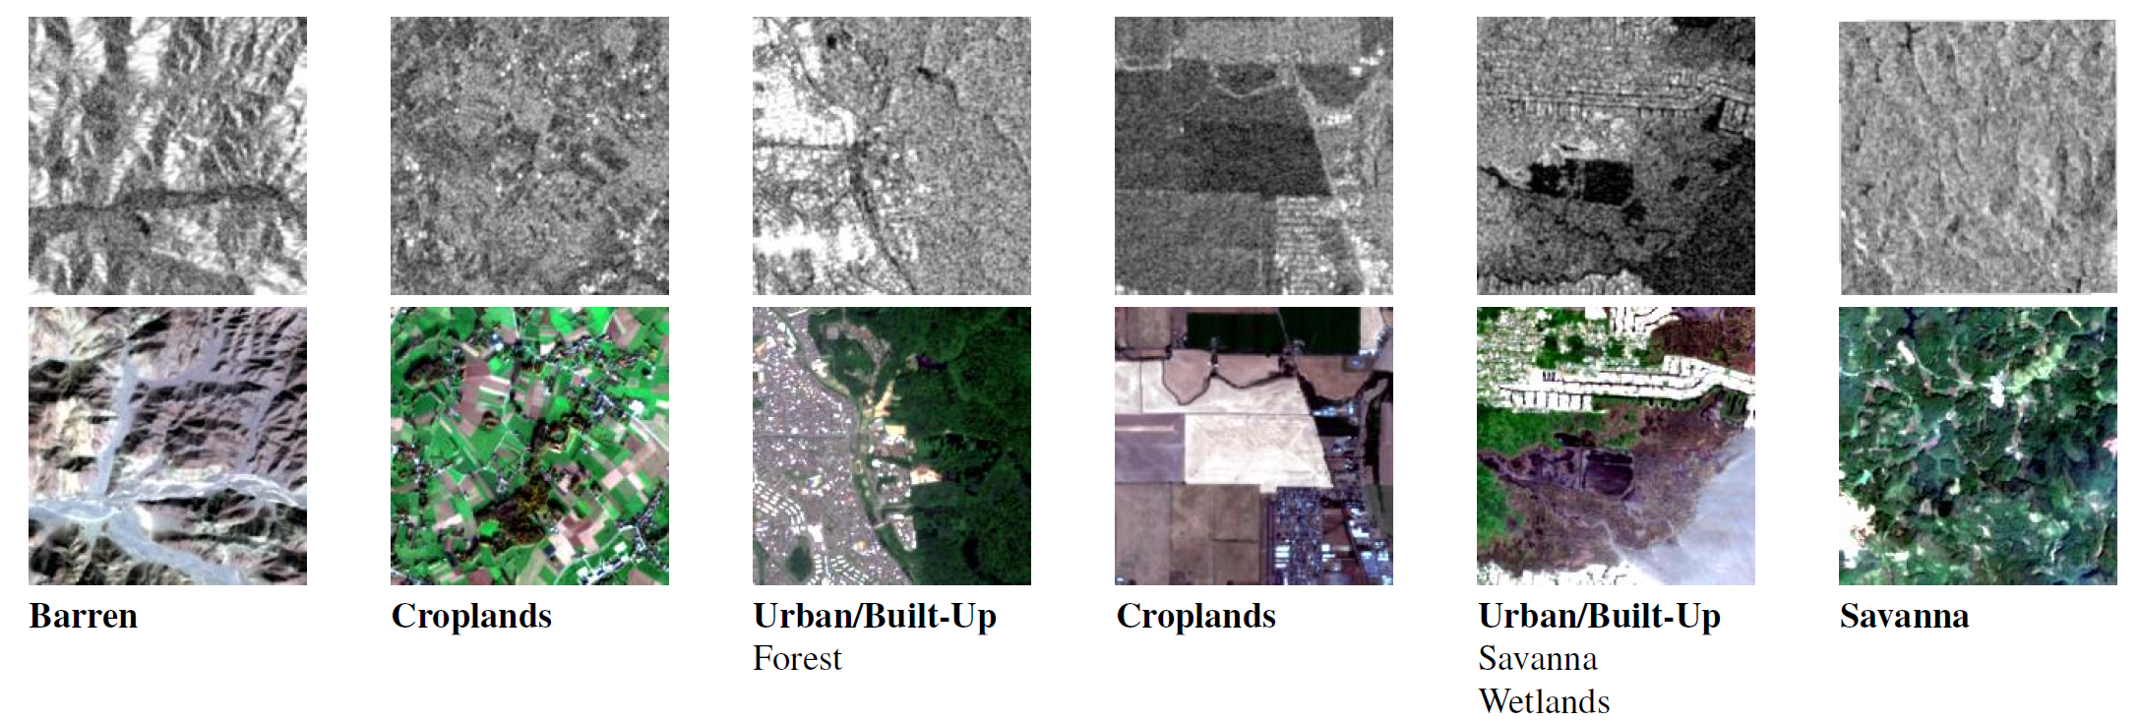
Min 75-85: Deep Learning to Emulate the Components of Earth System Models
Re-read the article and write down (1) the scientific goal of the paper; (2) One simple question with your neighbor. Example: How did the authors choose their best neural network architecture?

Slide 34
Which models work best to classify land cover from multi-sensor satellite imagery?
Problem: - Assigning labels to a given scene (scene classification) is technical
- Different models developed on different datasets→no objective comparison
Idea: Create a benchmark dataset to objectively compare different models
Results: Benchmark dataset + Comparison of ResNet & DenseNet

Slide 35
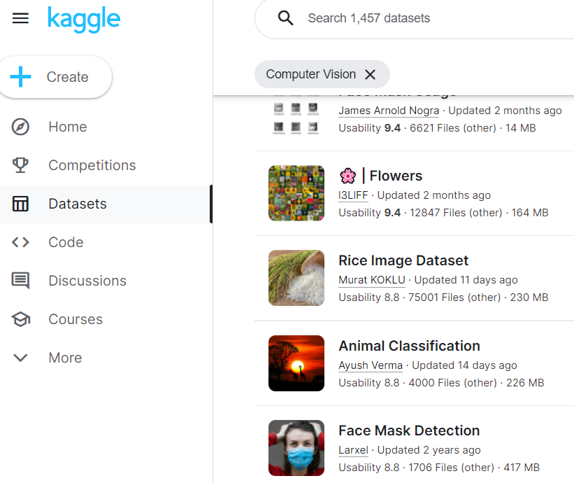
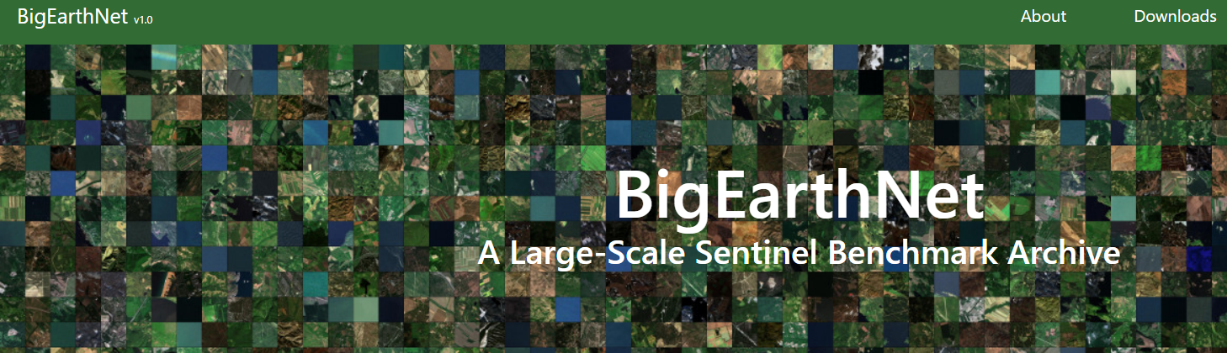
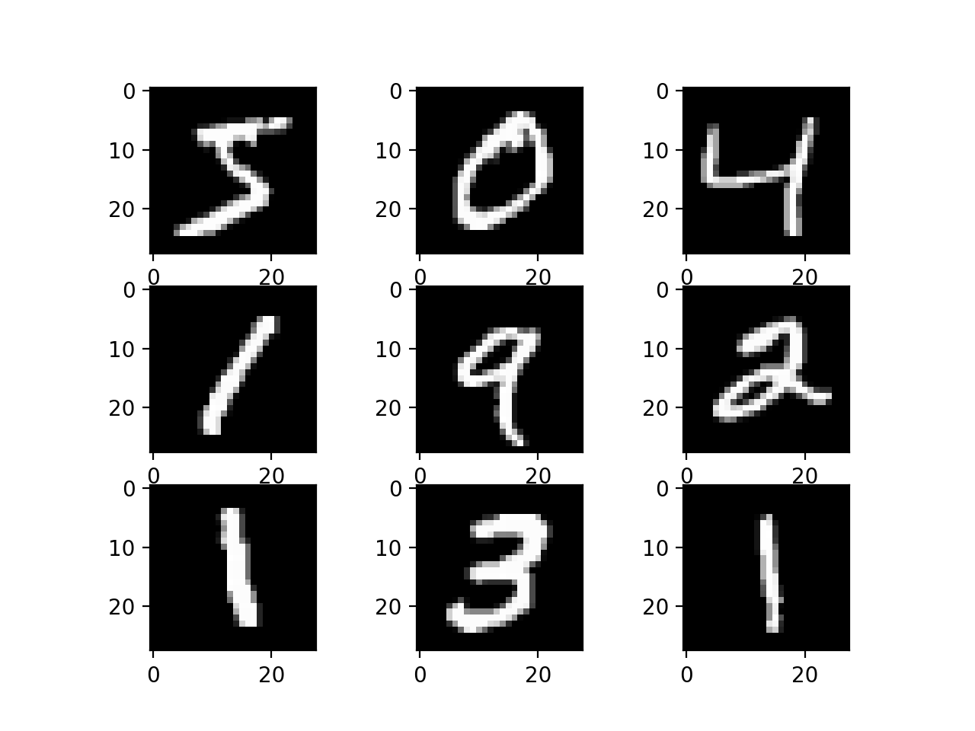
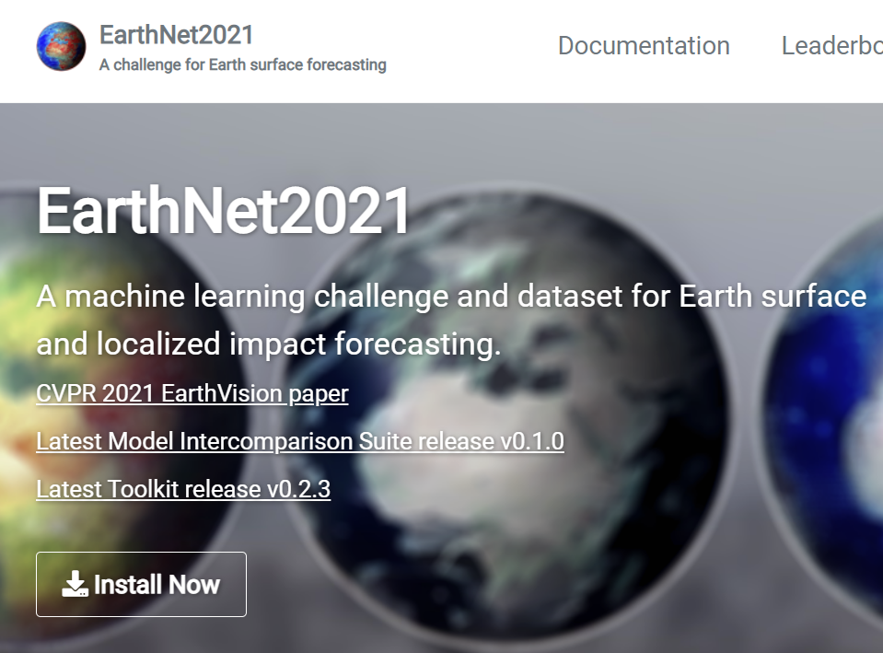
What is a benchmark dataset?
(Open) dataset used to objectively compare (ML) models for the same task

Slide 36
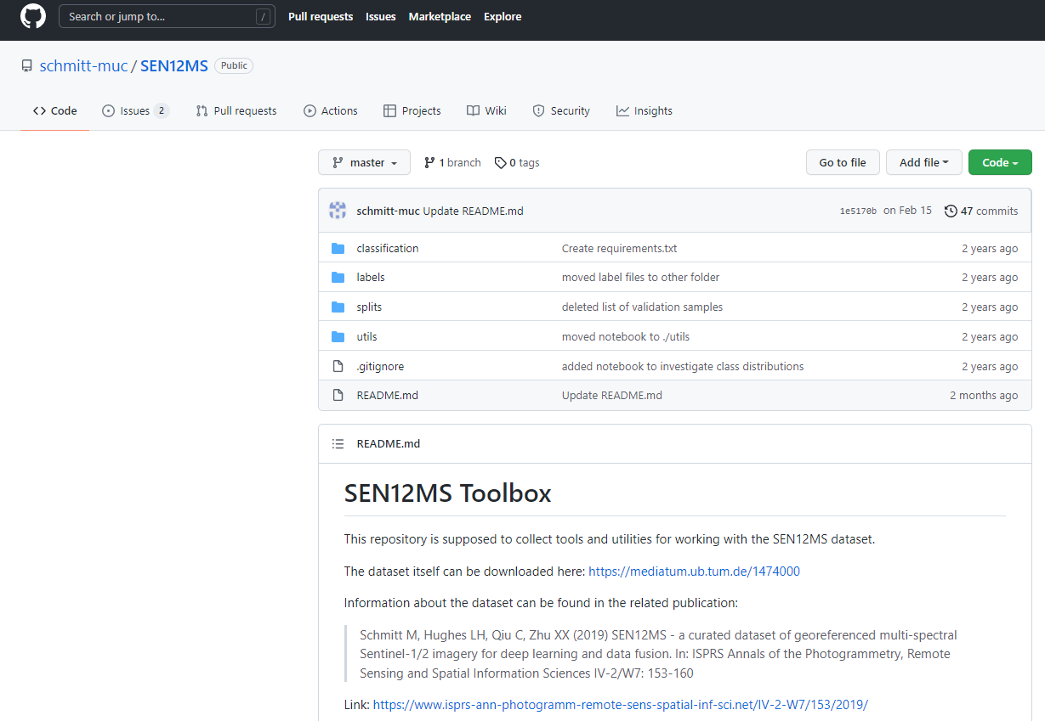
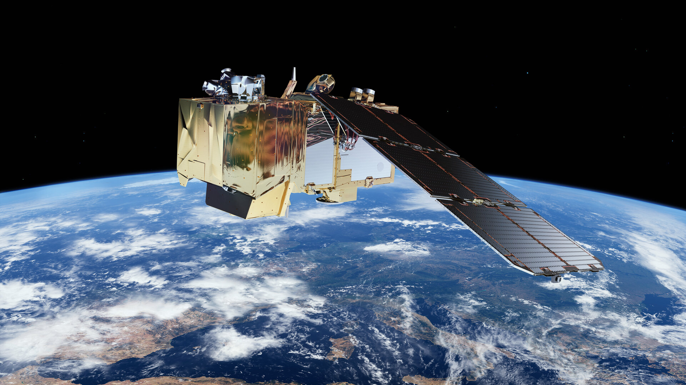
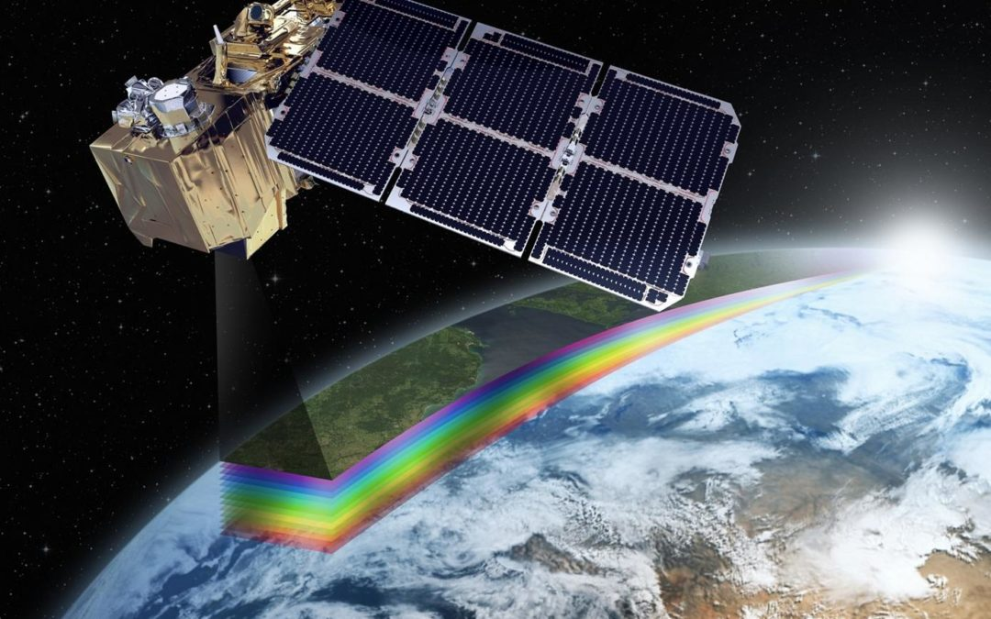
The authors proposed the SEN12MS Dataset
Open dataset used to objectively compare (ML) models for land-cover classification from multi-sensor, multi-spectral remote imagery
Sentinel:
Synthetic Aperture Radar image with 2 polarimetric channels
Sentinel-2 optical images with 13 multi-spectral channels
MODIS global land cover
Source: ESA, Cervest

Slide 37
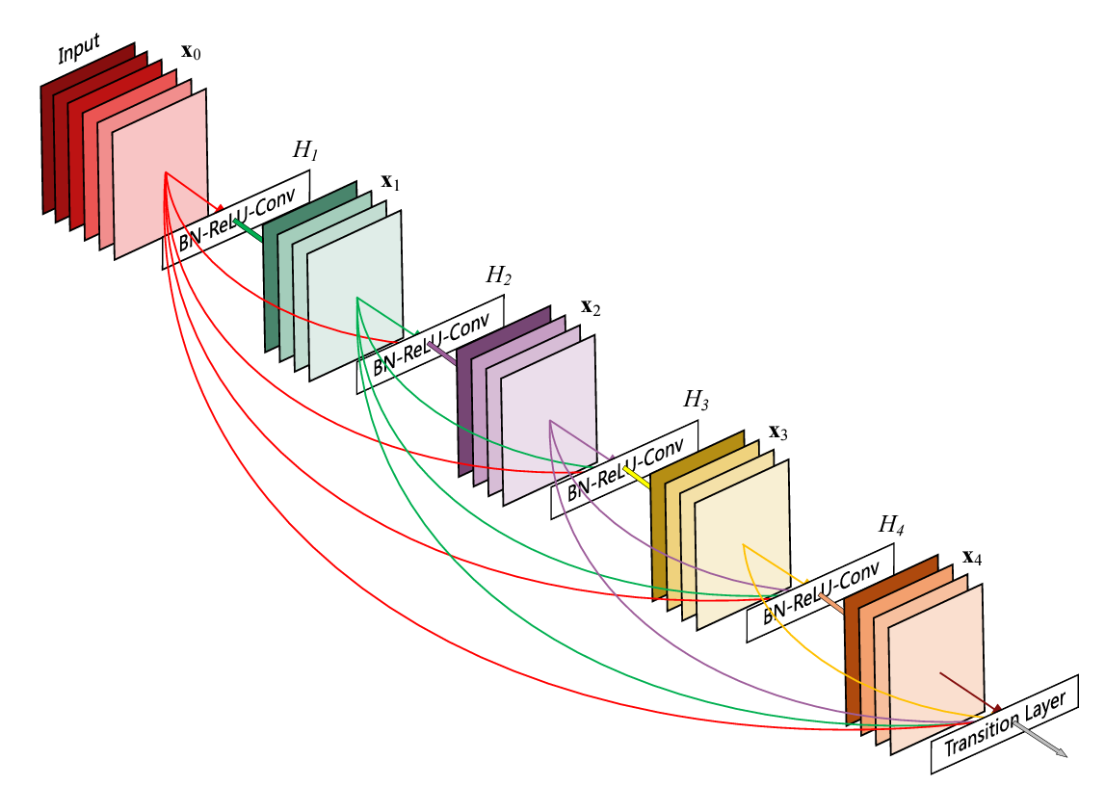
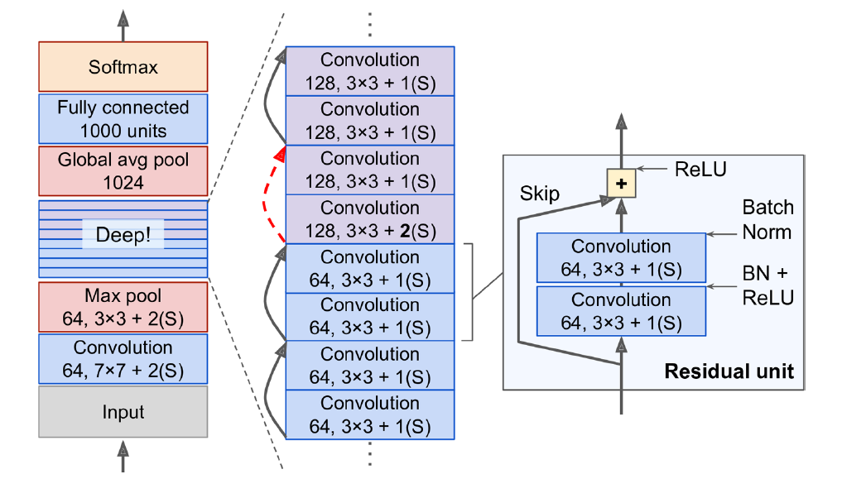
Compared the performance of ResNet vs DenseNet
Source: Géron Ch14, He et al. (2015), Huang et al. (2018)

Slide 38
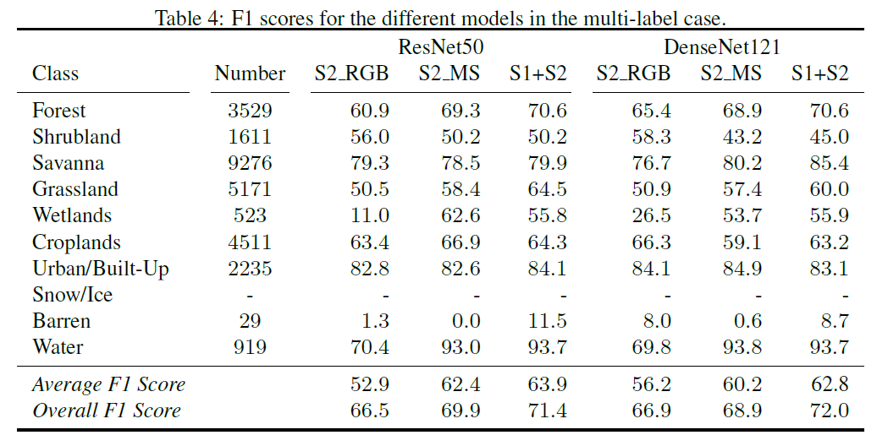
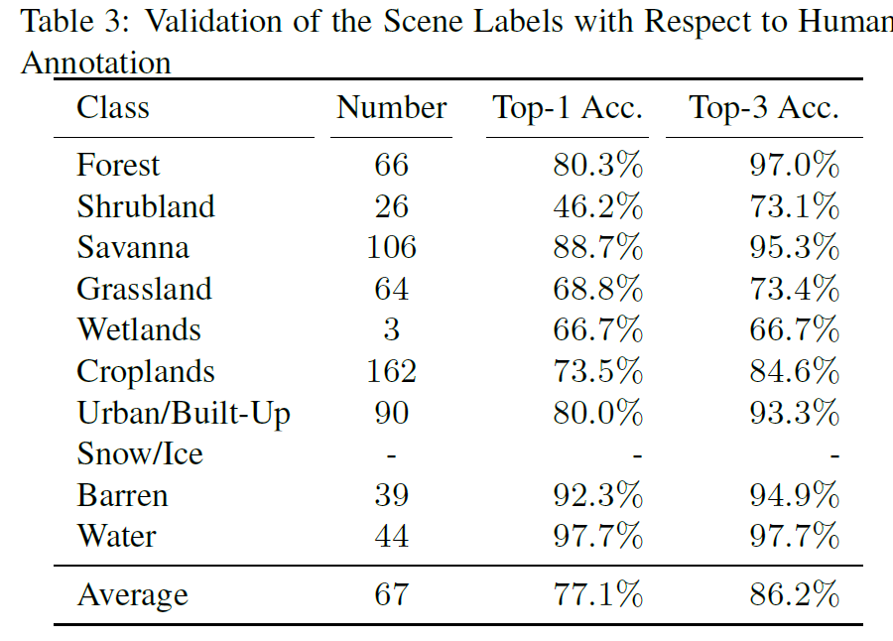
Compared the performance of ResNet vs DenseNet

Slide 39
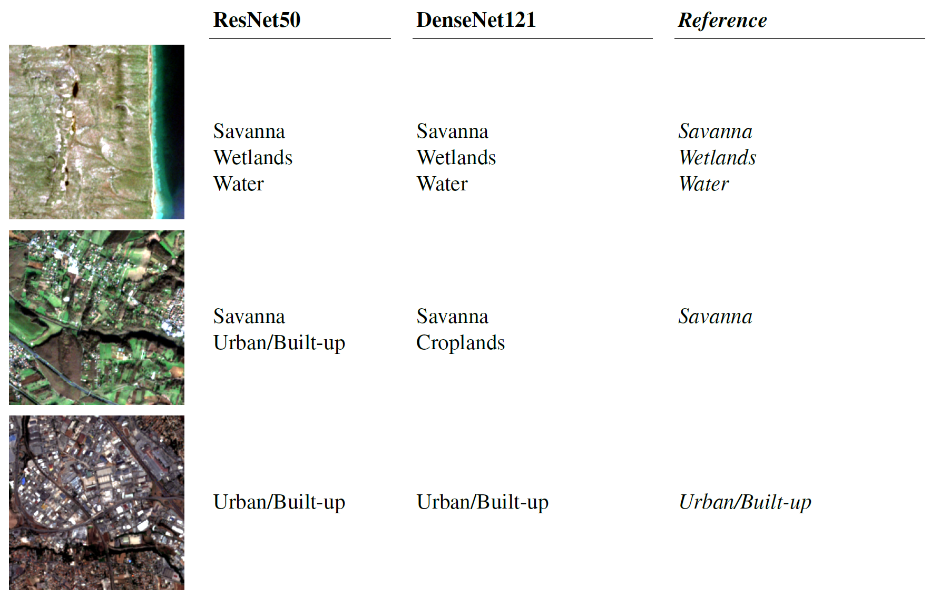
Neural Networks sometimes detect finer information than human-derived labels!

Slide 40
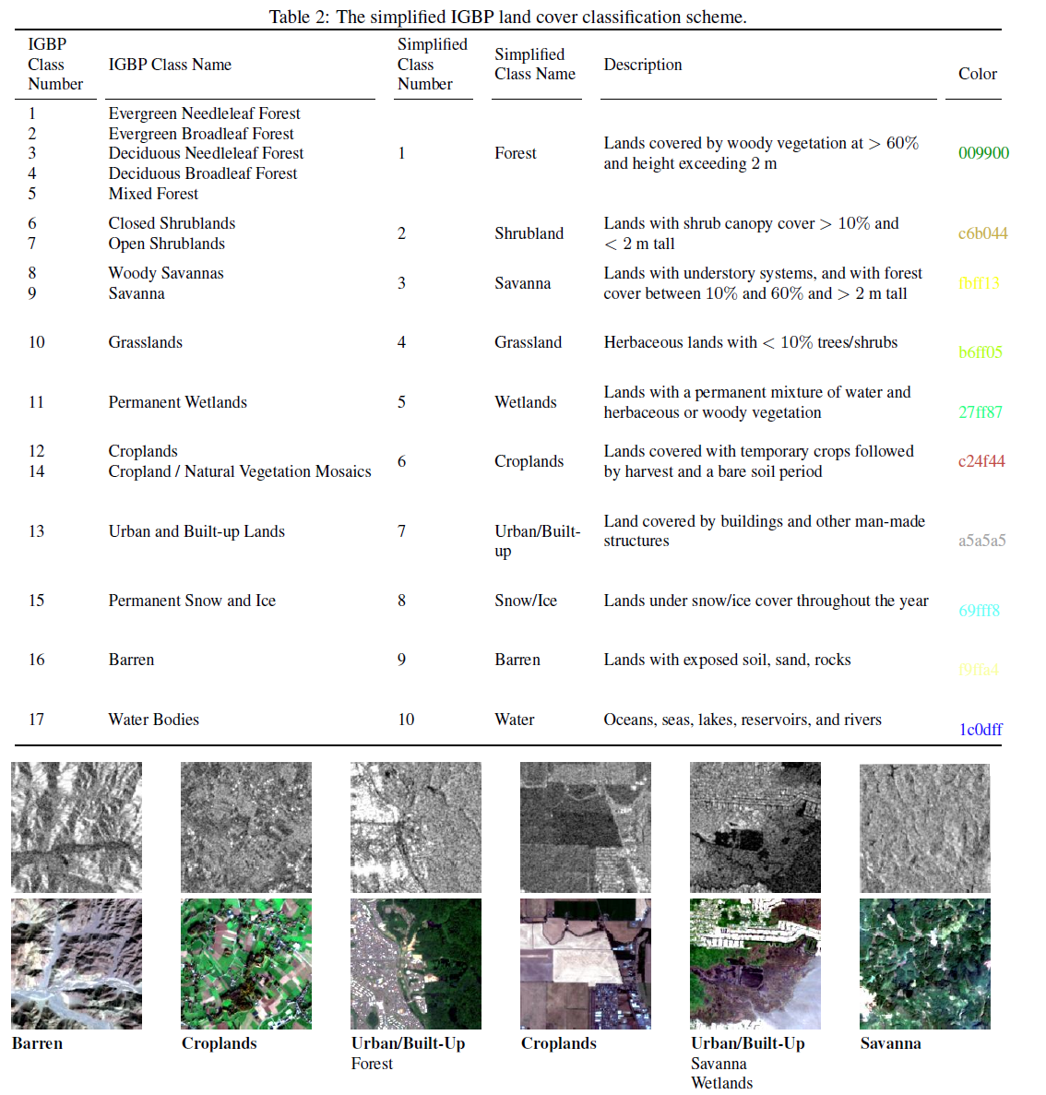
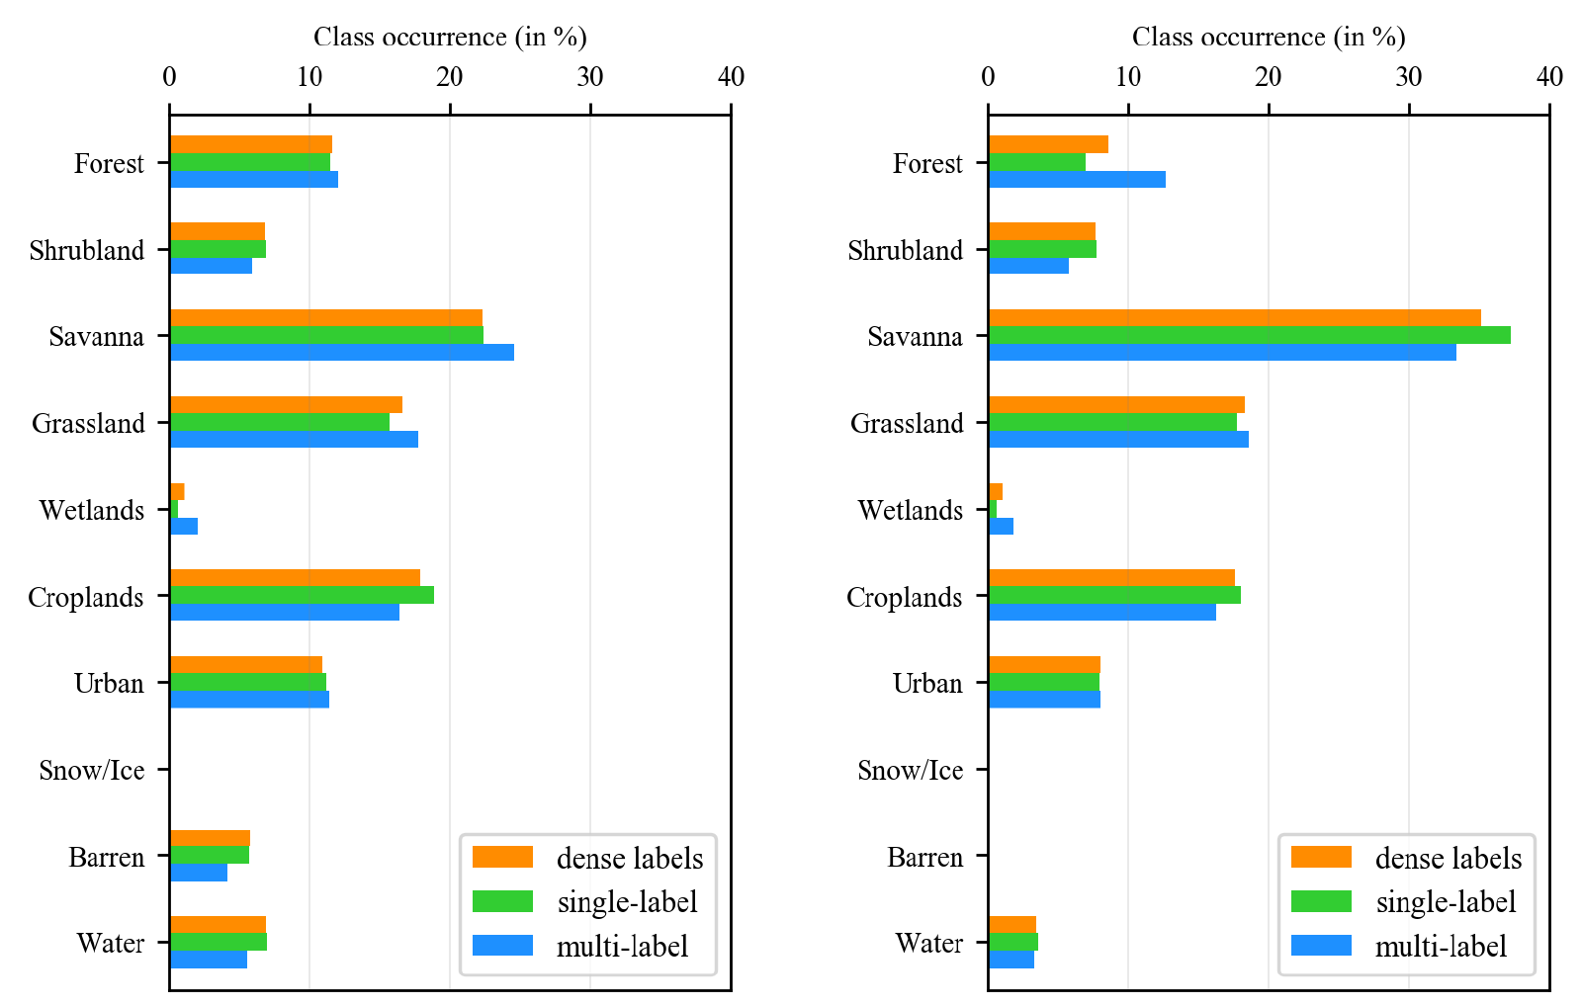

Slide 41
Mitigating Class Imbalance
Random oversampling = Randomly sampling more from minority class
Random undersampling = Sampling less from majority class
Collecting more data
Changing your loss function and/or performance metric
Generate synthetic data

Slide 42
Min 105-120: Review Moodle Quiz
Learning Objectives (Géron Ch14):
Define a convolutional neural network
Discuss the main applications of convolutional neural networks
Know the steps to design and train a convolutional neural network
Define transfer learning and understand how to re-use pre-trained models
Notes:
Questions?
Not graded

